Slide 1
Bit-Flip Attack: Crushing Neural Network with Progressive Bit Search
(2019)
Adnan Siraj Rakin†, Zhezhi He† and Deliang Fan
Presenter: Amirmohammad Pournaghshband

Slide 2
Introduction
We propose a Bit-Flip Attack (BFA) together with Progressive Bit Search (PBS) technique
Our proposed PBS combines gradient ranking and progressive search to locate the most vulnerable bits
Related work:
Row-Hammer Attack (RHA): to modify the data stored in DRAM memory cell by just flipping one bit at a time.

Slide 3
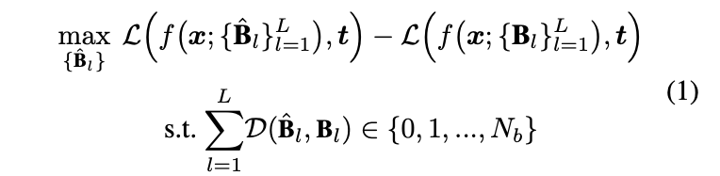
Methodology
$W$ is stored in the format of twos complement, which is denoted as $B$
Perturbed weights two’s complement representation is $B^{′}$.

Slide 4



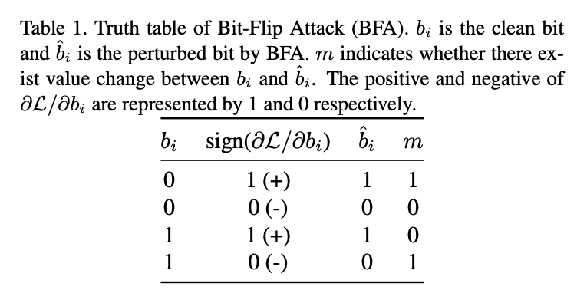
Methodology
Bit-Flip Attack:
flip the bits along its gradient ascending direction w.r.t the loss of DNN.
Naive Bit-Flip Attempt: since the bit value is constrained between 0 and 1 flipping the bit could lead to data overflow
We mathematically redefine the BFA as follows:
Bit-wise xor operator:
$m$ is the mask which indicates
whether to perform the bit-flip operation.

Slide 5
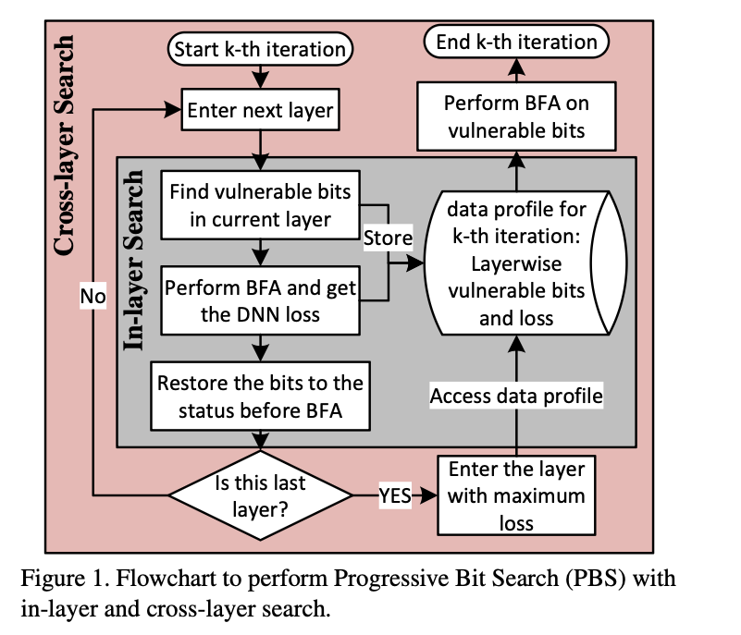
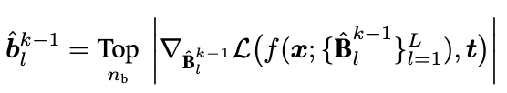

Methodology
Progressive Bit Search:
In-layer Search: Electing the $n_{b}$ most vulnerable bits in the selected layer. Record the inference loss if those elected bits are flipped
“Top” function returns the pointer pointing at the storage of those elected $n_{b}$ vulnerable bits
We apply the BFA on those elected bits
Evaluate the loss increment caused by BFA in Eq. (10)

Slide 6
Methodology
Progressive Bit Search:
Cross-layer Search: The cross-layer search first independently conduct the in-layer search on each layer
Generate the loss set as $[L_{1}^{k},L_{2}^{k}...L_{L}^{k}]$
Identify the layer $j$ with maximum loss and reperform the BFA (without restore) on the bits elected in $j$th layer.
Time Complexity of BFA with PBS:
For each iteration of PBS to identify single most vulnerable bit, the time complexity is $O(L.N)$
$L$ is the number of total convolution and linear layers
$N$ is the number of bits with highest gradient ranking that will be checked in PBS method

Slide 7
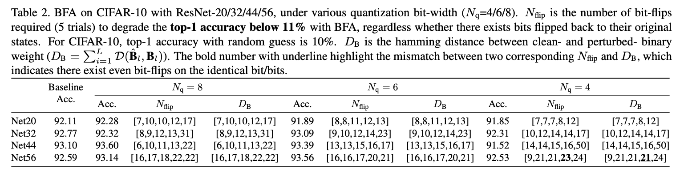
Results
Datasets:
ImageNet
CIFAR_10
For CIFAR-10, experiments are conducted on a series of residual network (ResNet-20/32/44/56), where the weights are quantized into 4/6/8 bit-width with retraining.

Slide 8
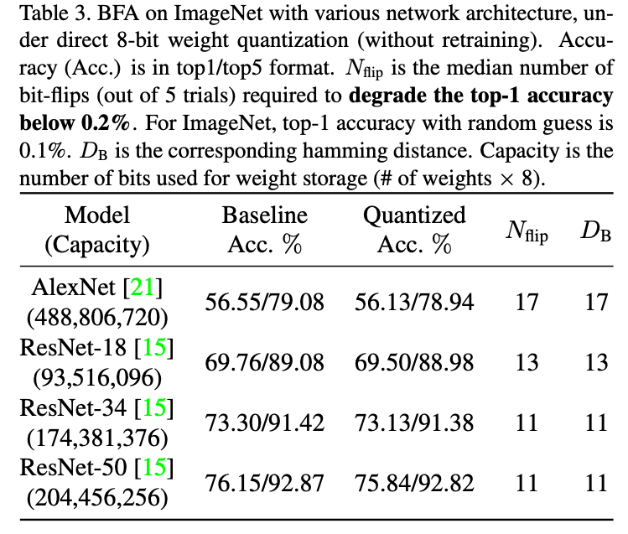
Results
ImageNet:
Since ImageNet dataset has 1000 different classes of objects, a classification accuracy of 0.1% can be considered as random output

Slide 9
Blind Data Adversarial Bit-flip Attack against Deep Neural
Networks (2022)
Behnam Ghavami, Mani Sadati, Mohammad Shahidzadeh, Zhenman Fang, Lesley Shannon
Presenter: Amirmohammad Pournaghshband

Slide 10
Introduction
Previous attacks rely on flipping a small number of bits in DNN weights, but they assume access to training/testing data — often unavailable in sensitive settings.
Motivation: Many applications (e.g., in healthcare) don’t allow data access due to privacy and regulatory restrictions. There is a need for attacks that do not require any data — “blind” attacks.
Contribution:
Introduced the first Blind Data Bit-Flip Attack (BDFA) — performs parameter attacks without access to any real data.
Synthetic Data Generation: Input normalization, Batch normalization statistics, Targeted output label
Achieve similar or better performance than white-box BFA

Slide 11
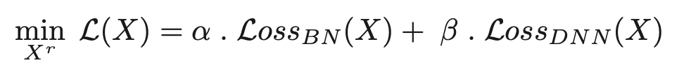
Methodology
Bit-Flip Attack (BFA):
Uses gradients to rank parameter bits for flipping
Requires real input/output data
Blind Data Bit-Flip Attack (BDFA):
Synthetic Data Generation:
Input Normalization: Start with random data, normalized (mean=0, std=1)
BatchNorm Statistics: Optimize synthetic data to match BN layer stats (mean & std)
Label Similarity: Randomly assign labels and backpropagate to minimize model loss
Combined Loss Function:

Slide 12
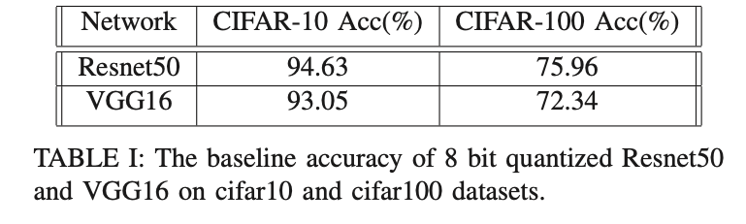
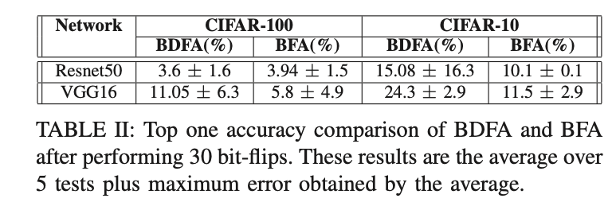
Results
Setup:
Datasets: CIFAR-10, CIFAR-100
Models: ResNet50, VGG16
All weights are quantized to 8 bits
CIFAR-100:
ResNet50: Accuracy drops from 75.96% to 13.94% (4 bits), 3.6% (30 bits)
VGG16: Accuracy drops to 11.05% (30 bits)
CIFAR-10:
ResNet50: Drops to 15.08% (30 bits)
VGG16: Drops to 24.3% (30 bits)

Slide 13
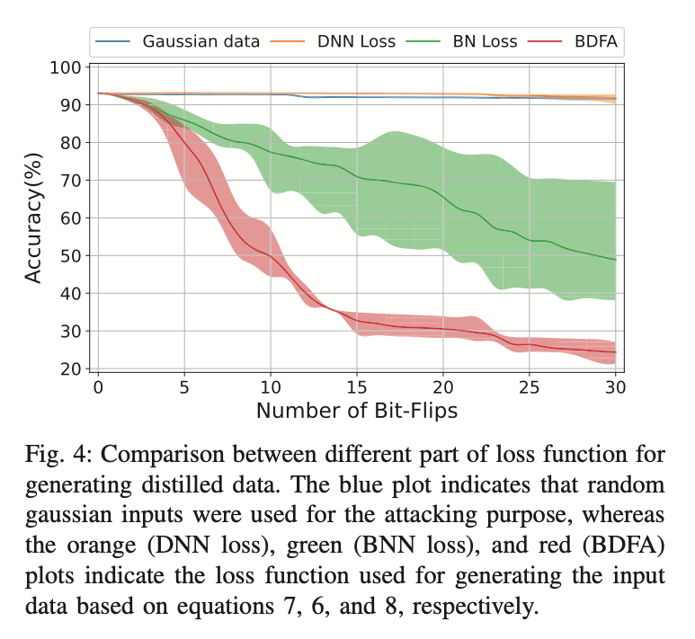
Results

